Slide 1
Attendance Questions
At attendance time, instead of calling roll and having students say “here,” I ask them to answer a question with a succinct answer. This way I get to know them better. They get to know each other better. And they get to know that I am interested in them! The questions can be serious or funny, asked aloud or projected on an image slide.
Ready to try it? Great! To make it easy for you to get started with attendance questions, I’ve created fifteen fun image slides you can use in the first three weeks of school (including all those pictured in this post). Sign up for her free Friday teaching idea emails to receive free resources like this.
Developed by Betsy at Spark Creativity
3 Weeks

Slide 2

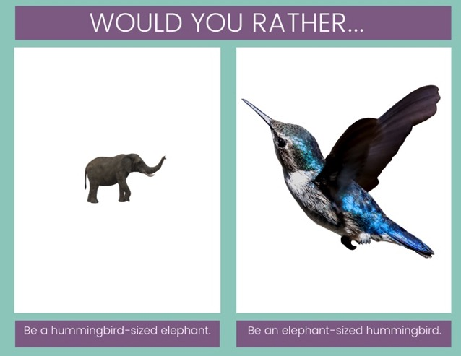
Try Would you Rather Questions
Would you rather questions are so easy, whether you use images or words. Would you rather own a restaurant or a clothing company? Would you rather take only art classes or only music classes? Would you rather be on water skis or snow skis? Would you rather eat only chocolate or eat only cheese?

Slide 3


Slide 4
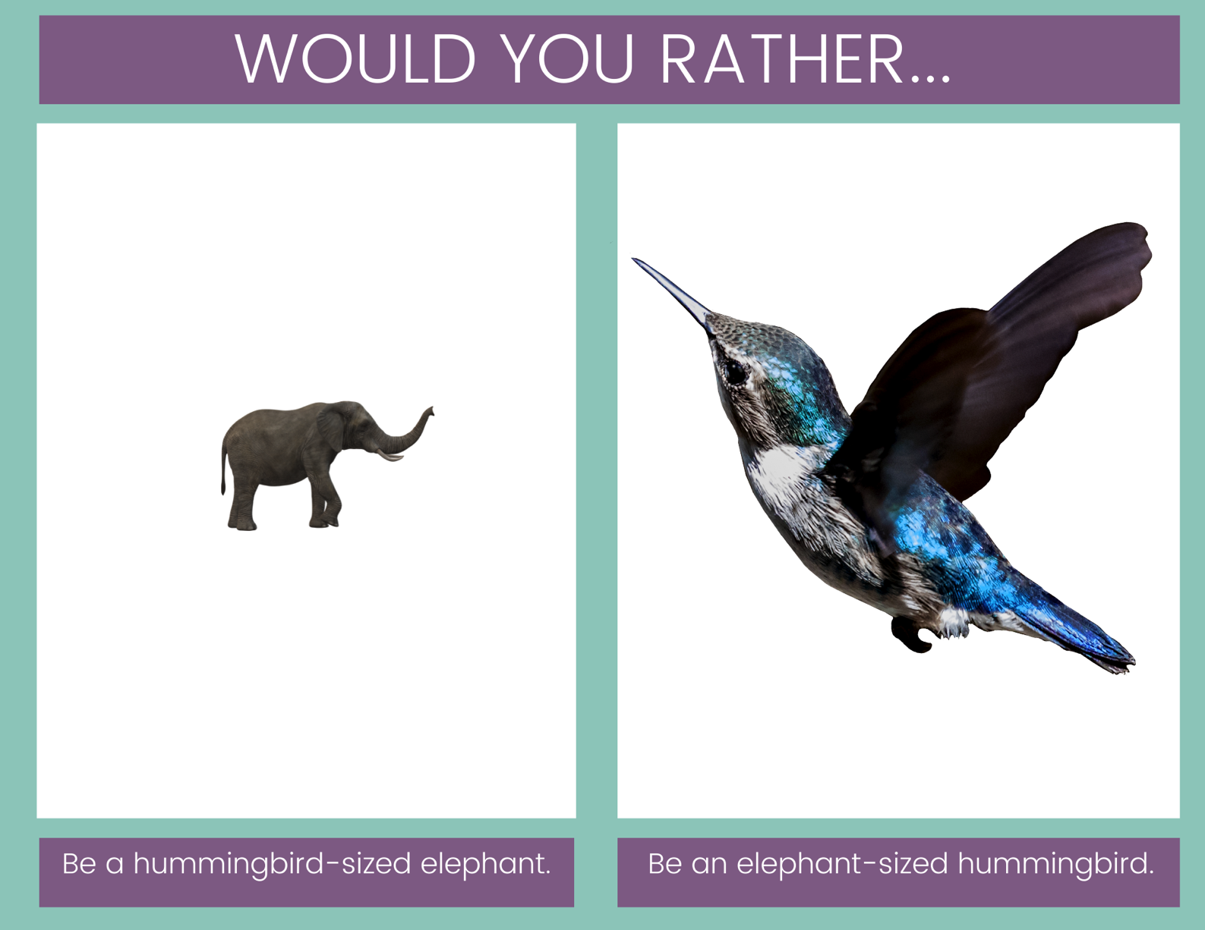

Slide 5
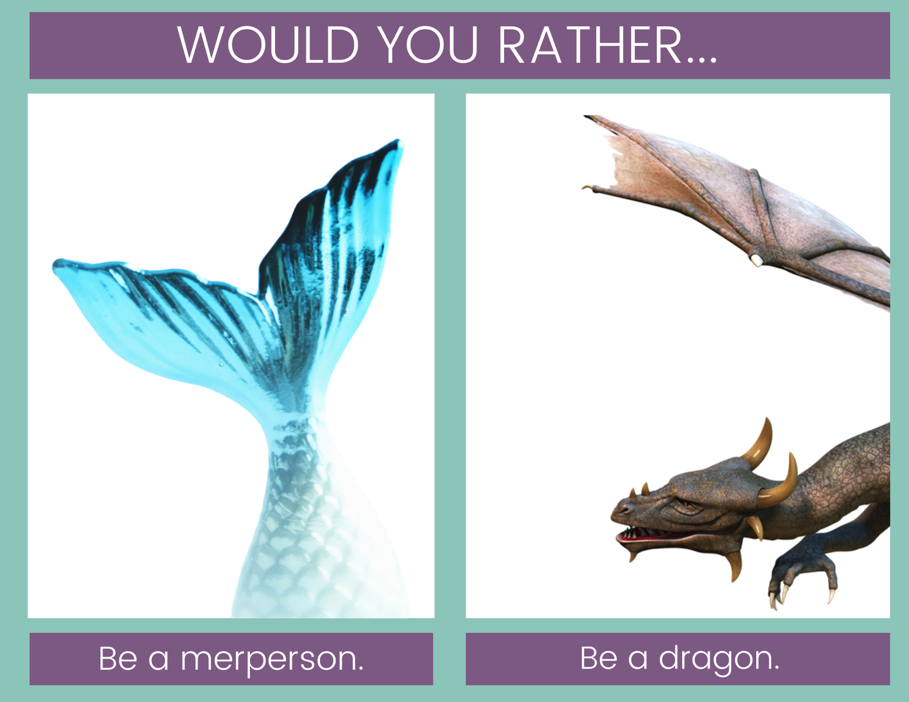

Slide 6
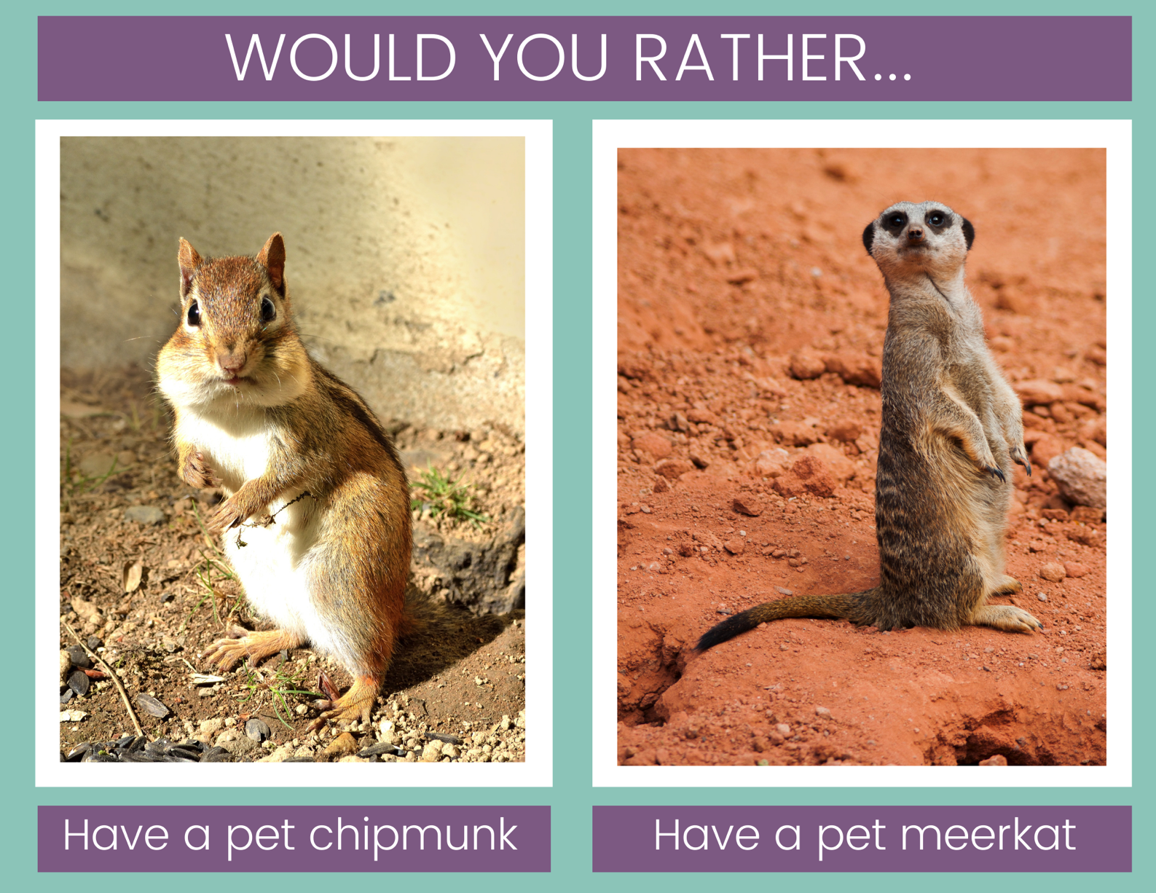

Slide 7


Slide 8
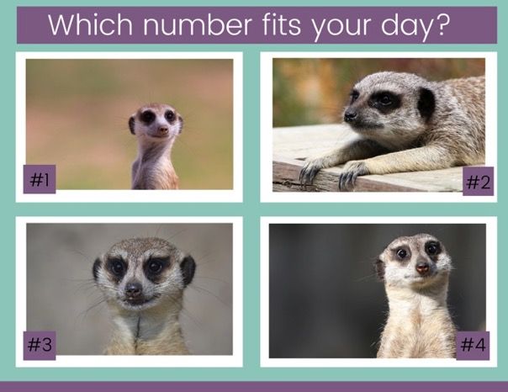
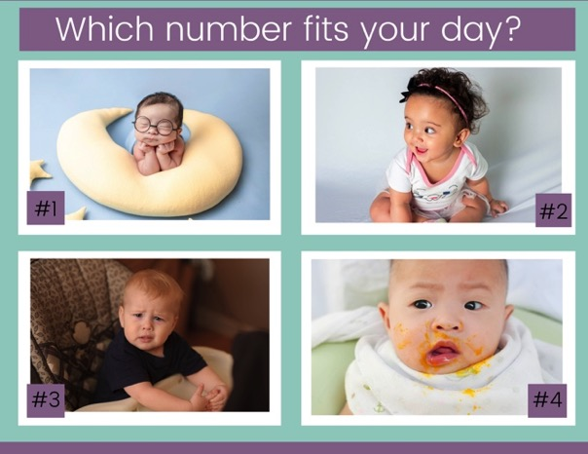
Try Number Scales
These tend to bring a little humor into the day alongside the chance to check in with how students are feeling. Offer as as many choices as you want and let students choose the image that fits their mood, their day, their week, etc. It gives them a funny outlet to share that they’re exhausted, frustrated, happy, energized, confused, etc.

Slide 9


Slide 10


Slide 11
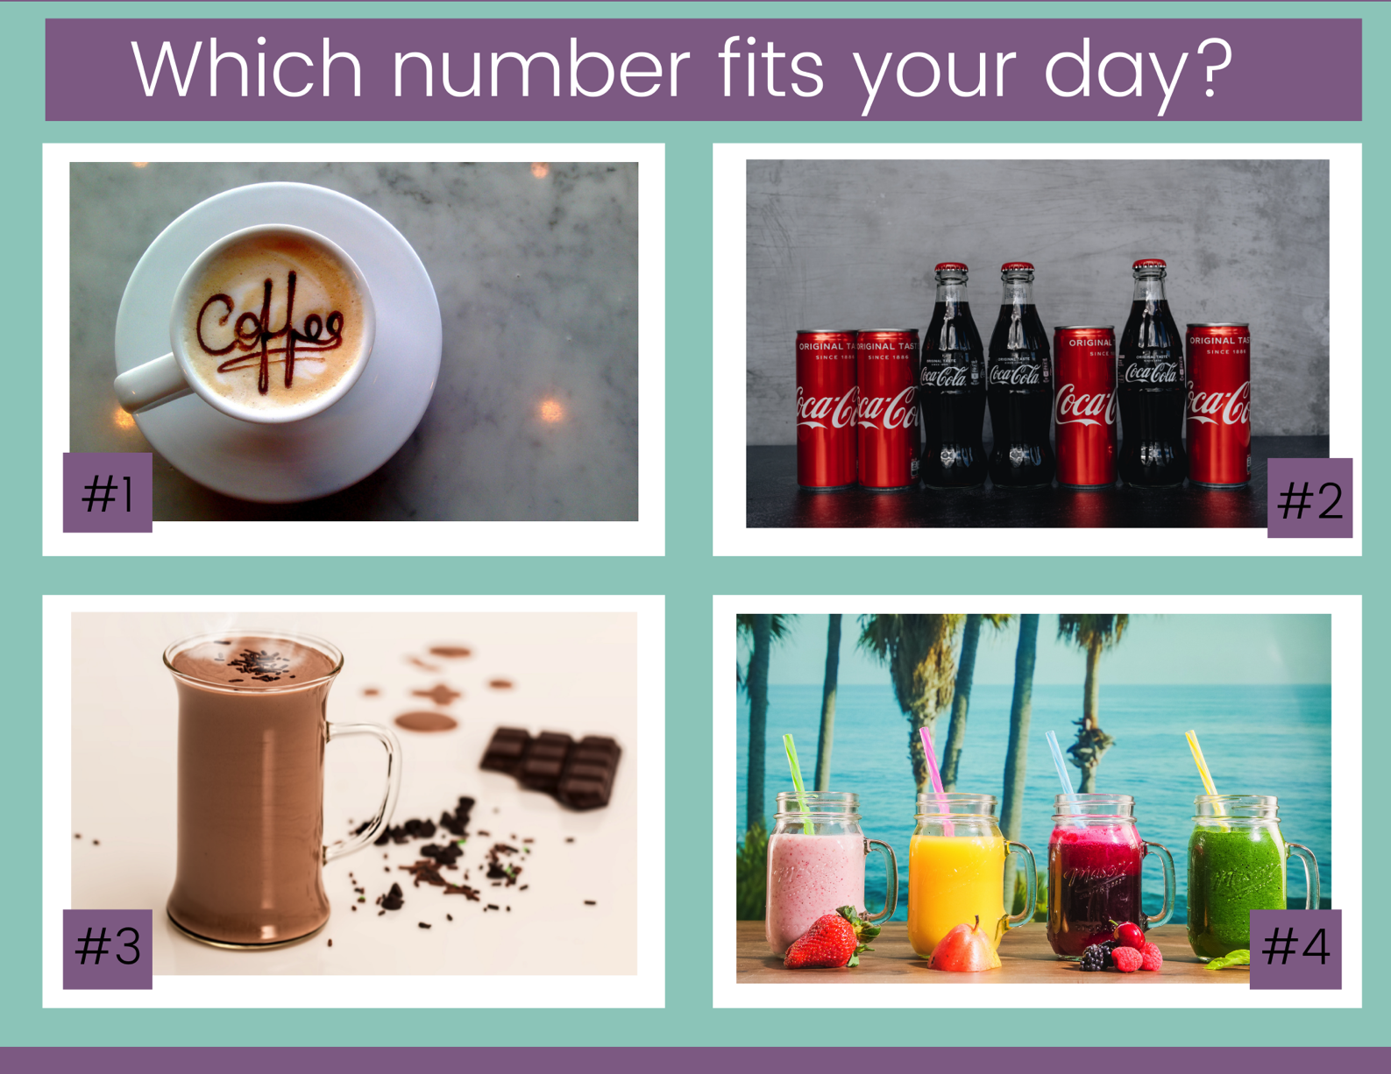

Slide 12
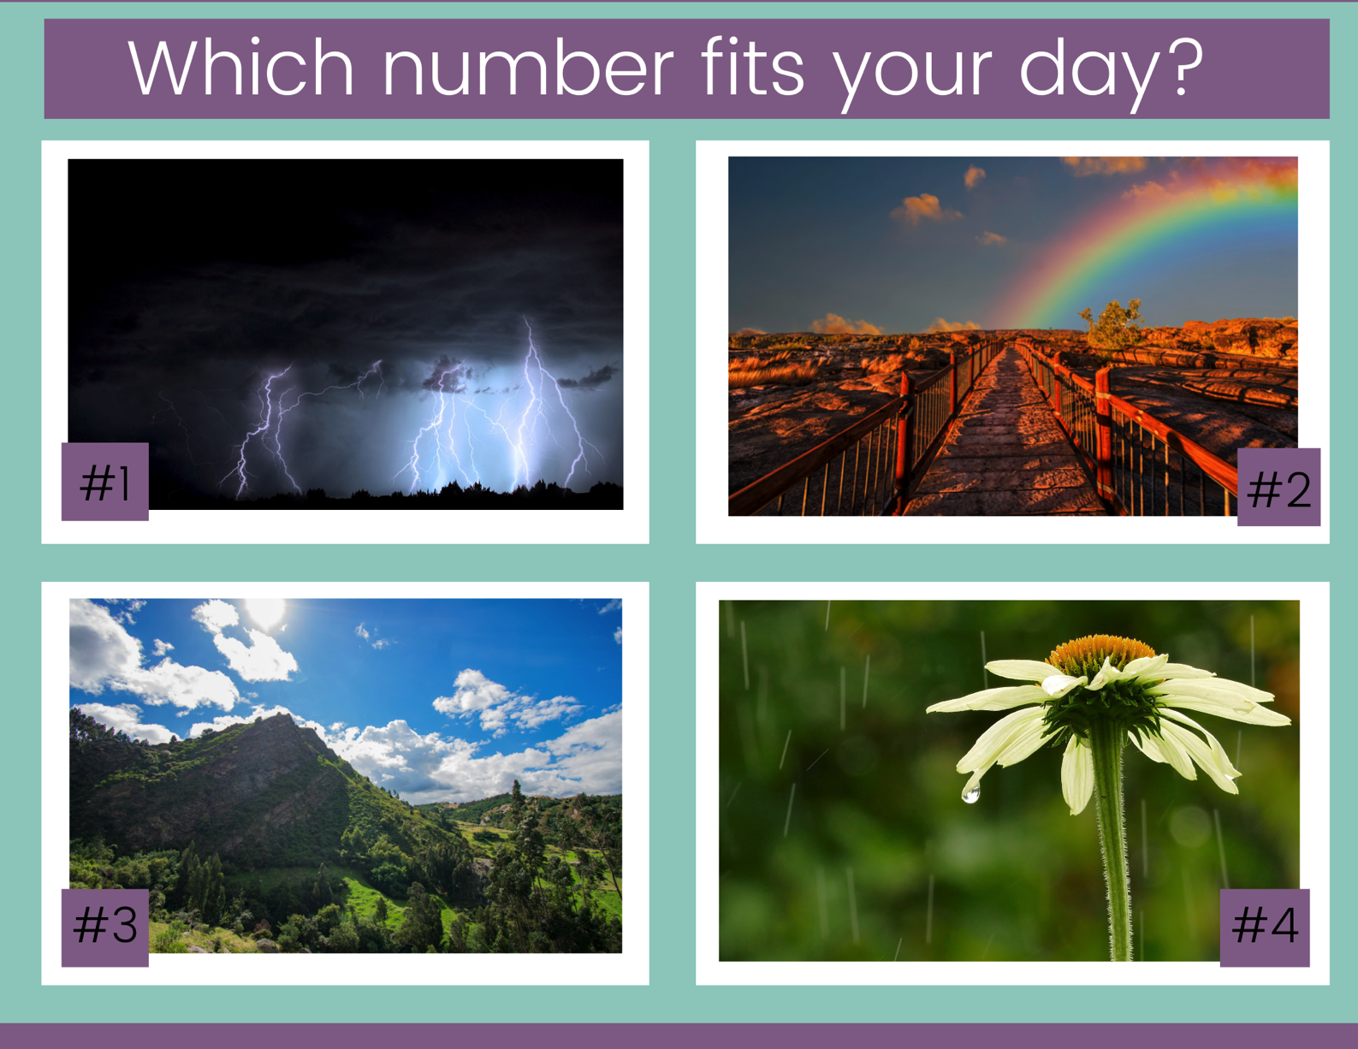

Slide 13
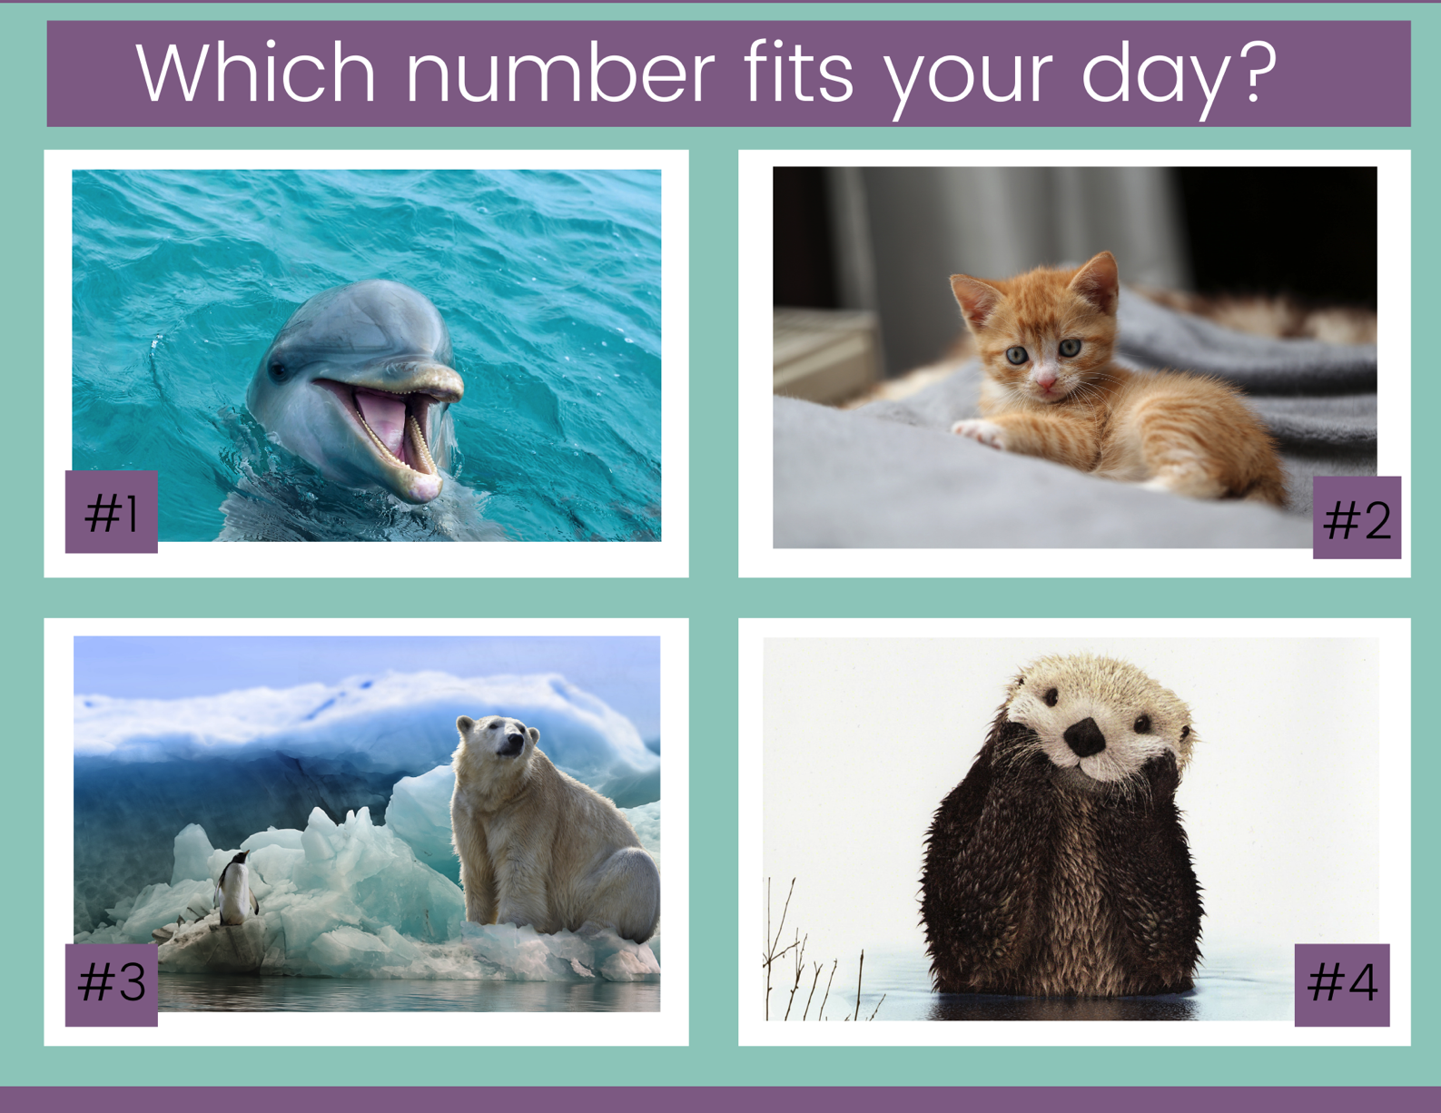

Slide 14
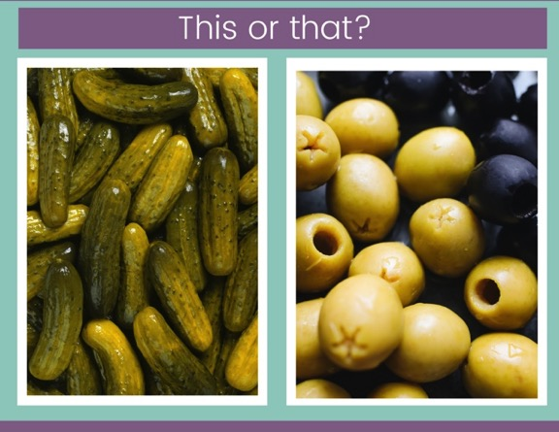
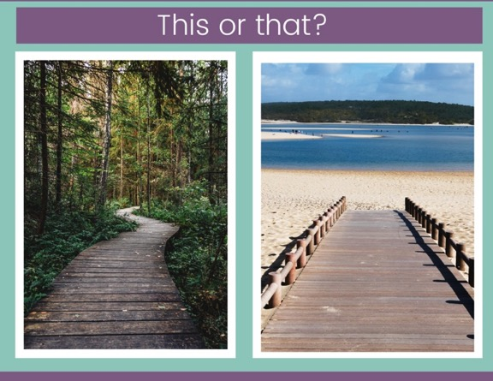
Try This or That
These questions are so simple, and actually quite fun to come up with. Watch in amazement as students go seriously to bat for their favorite fast food chain, their preference for chocolate milk, their love of Game of Thrones versus Modern Family, or whatever else you choose to put in your this or that question.

Slide 15
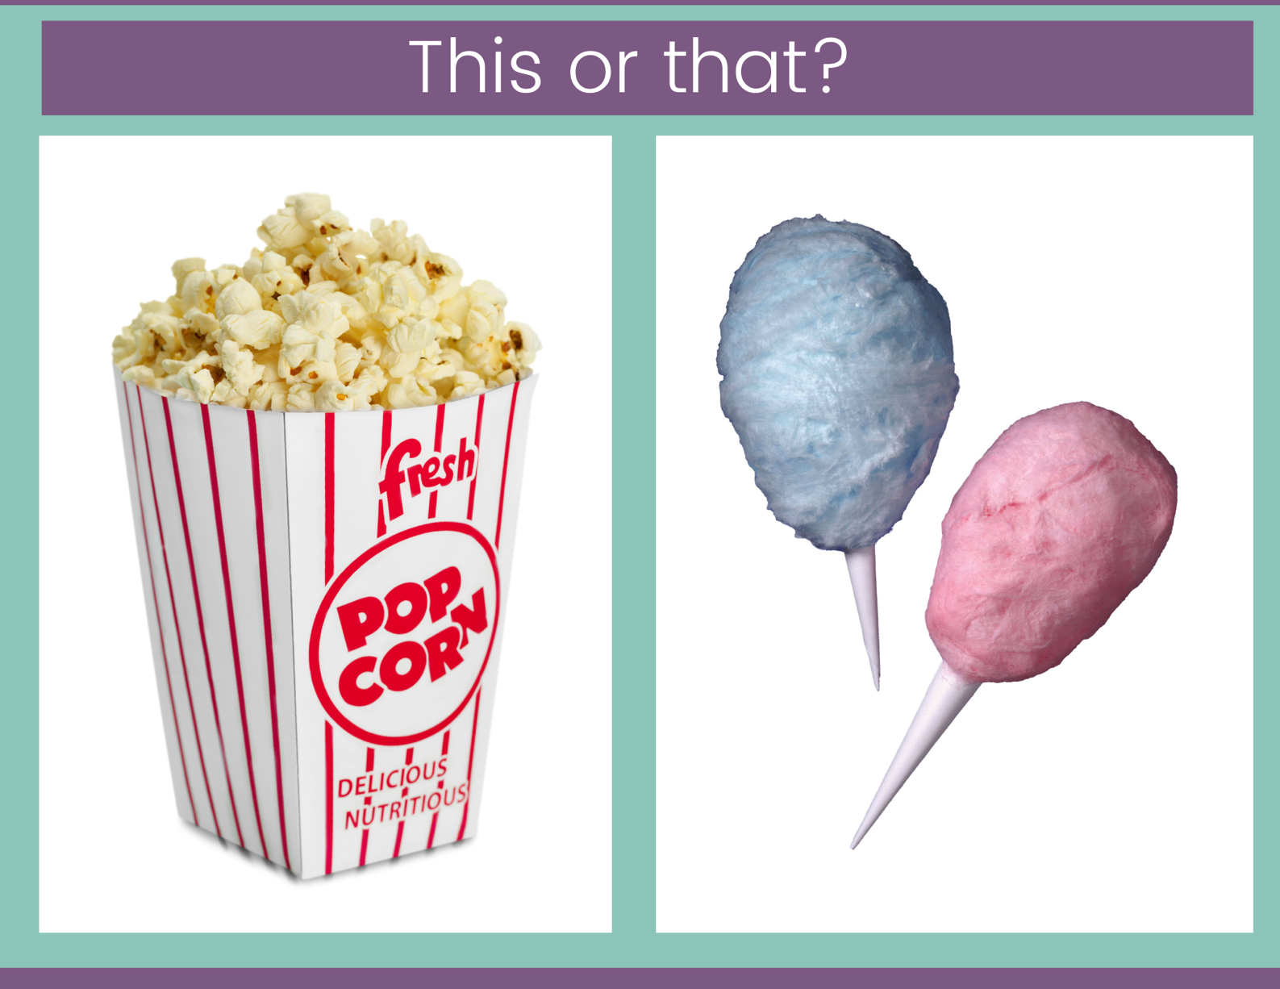

Slide 16


Slide 17


Slide 18
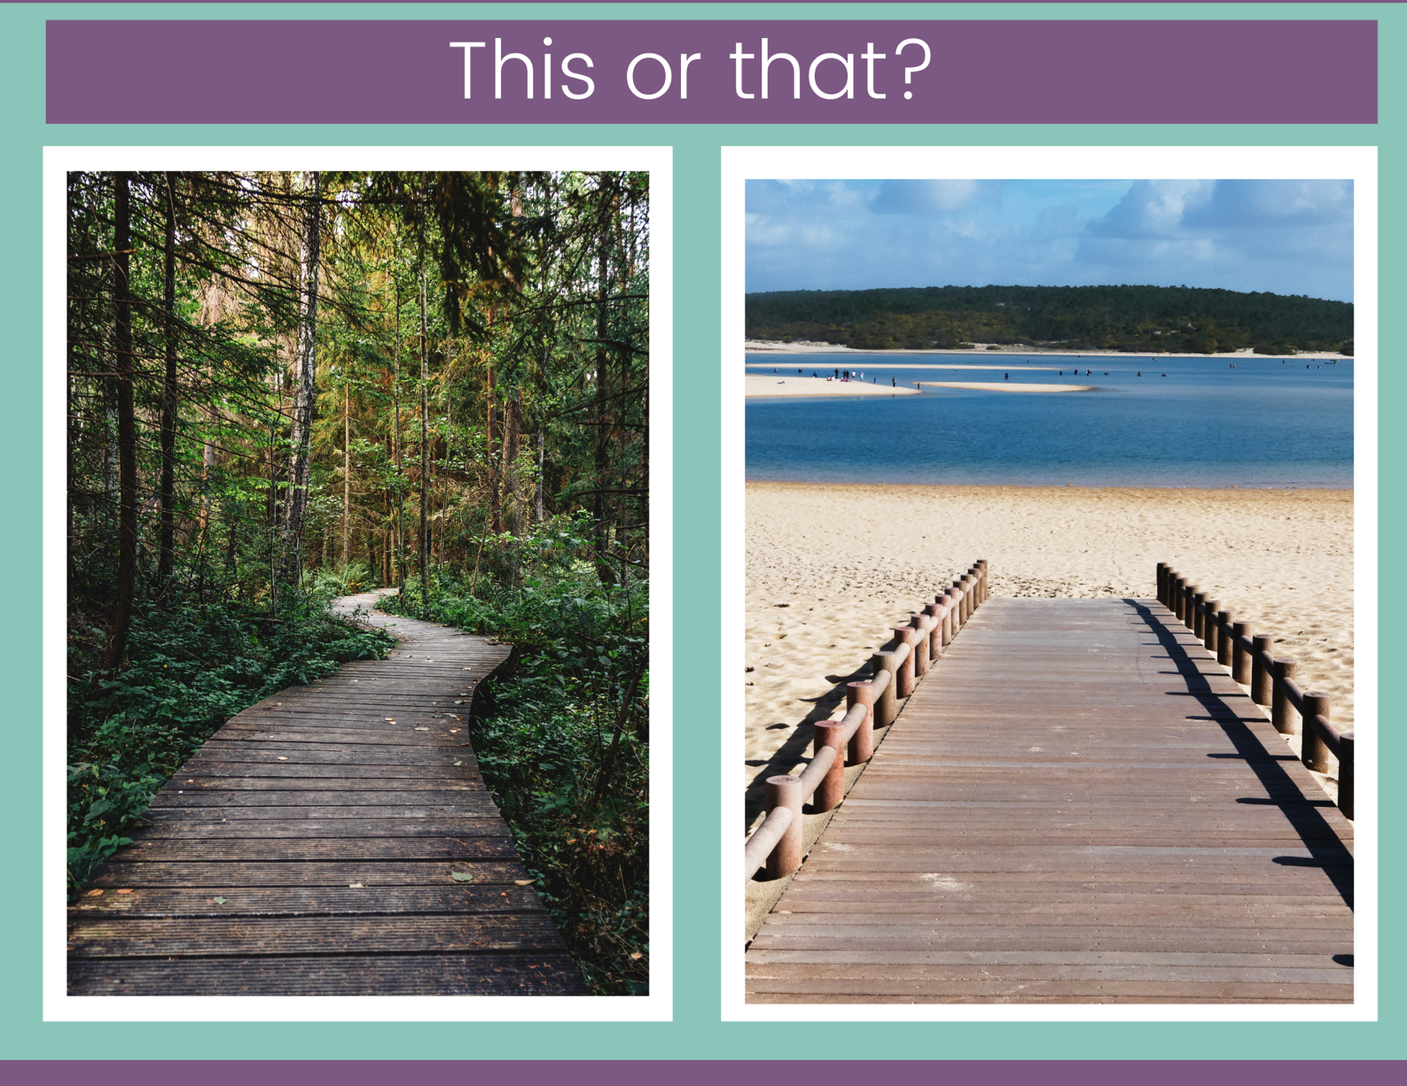

Slide 19
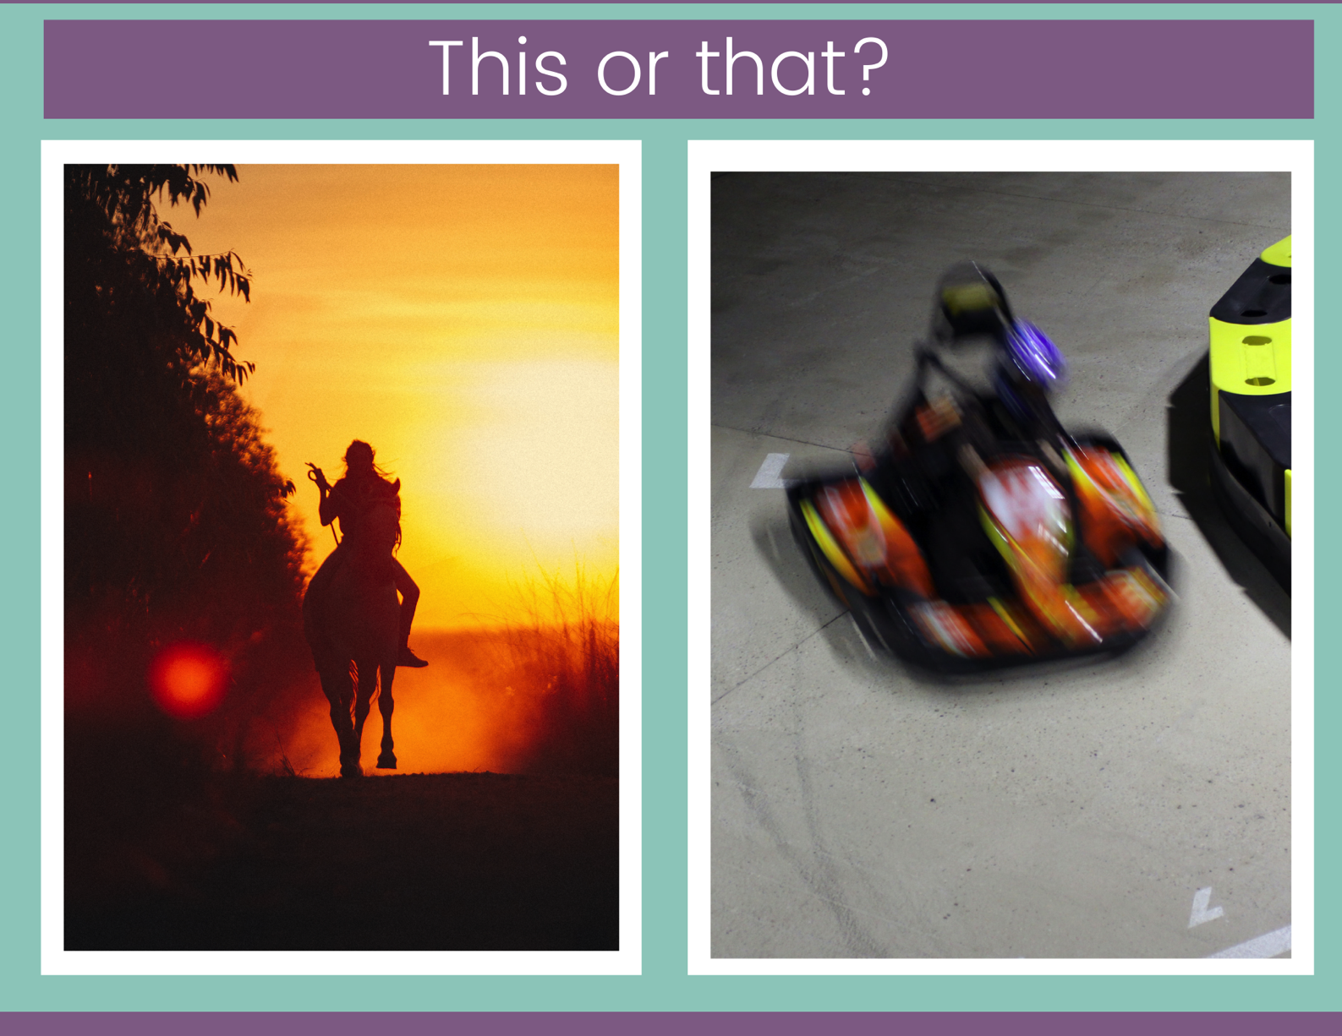

Slide 20
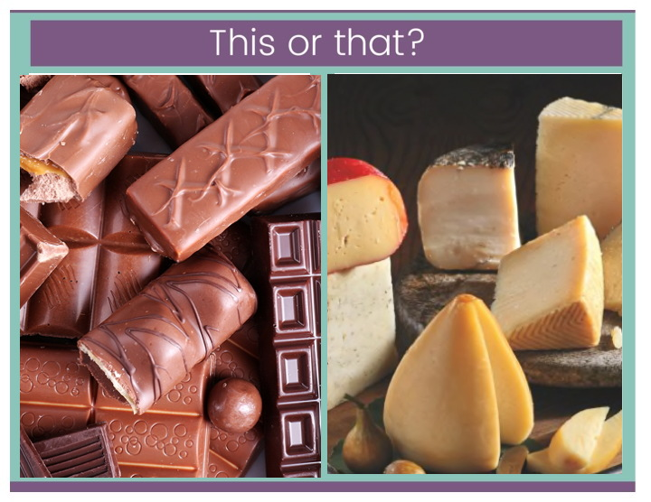

Slide 21
Open-ended Opinions
These questions are so simple, and actually quite fun to come up with. Ask for personal background, favorites, hopes, and dreams. Once you know your students a bit, use your knowledge about them to get to know them even better.

Slide 22

Where are you from?

Slide 23
Where do you want
to go on vacation?

Slide 24
Where do you hope
to live when it’s up
to you?

Slide 25
What do you want
to do for your job someday?

Slide 26
What’s one thing you know how to cook?

Slide 27
What language would you like to learn that you don’t already know?

Slide 28
What’s something
you wish you knew how to do?

Slide 29
If you could only listen to one song
for the rest of your life, what song would it be?

Slide 30
Which sports team,
if any,
do you cheer for?

Slide 31
What famous person do you admire most?

Slide 32
What’s your favorite color?

Slide 33
What’s your favorite book?

Slide 34
Which movie have you seen the most times?

Slide 35
What’s your favorite restaurant?

